Slide 1
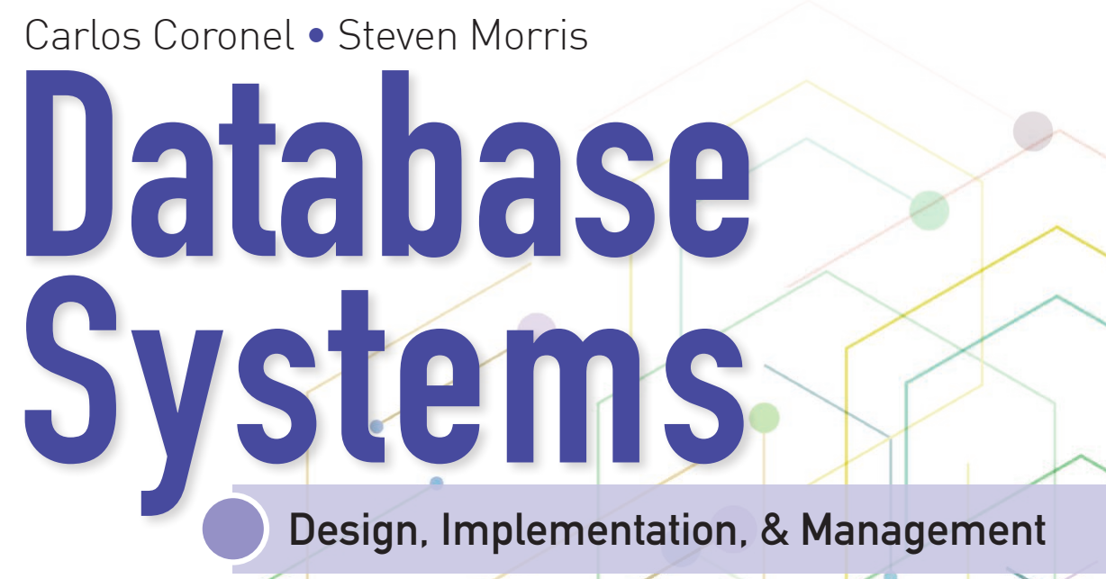
Learning Objectives
Define the difference between data and information
Describe what a database is, the various types of databases, and why they are valuable assets for decision making
Explain the importance of database design
Outline how modern databases evolved from file systems
Identify flaws in file system data management
Outline the main components of the database system
Describe the main functions of a database management system (DBMS)

Slide 2


National Economics University Faculty of Data Science & Artificial Intelligence
Database System Design, Implementation And Management Course – Introduction to Structured Query Language (SQL)
Instructor: Duc Minh Vu (FDA – SLSCM Lab)
Email: minhvd [at] neu.edu.vn
12/19/2024
Database System Design, Implementation And Management
2

Slide 3
Learning Objectives
7-1 Retrieve specified columns of data from a database
7-2 Join multiple tables in a single SQL query
7-3 Restrict data retrievals to rows that match complex criteria
7-4 Aggregate data across groups of rows
7-5 Create subqueries to preprocess data for inclusion in other queries
7-6 Identify and use a variety of SQL functions for string, numeric, and date manipulation
7-7 Explain the key principles in crafting a SELECT query

Slide 4
7-1 SQL Basics

Slide 5
7-1 SQL Basics
It is a data manipulation language (DML).
SQL includes commands to insert, update, delete, and retrieve data within the database tables.
It is a data definition language (DDL).
SQL includes commands to create database objects such as tables, indexes, and views, as well as commands to define access rights to those database objects.
It is a transaction control language (TCL).
The DML commands in SQL are executed within the context of a transaction, which is a logical unit of work composed of one or more SQL statements, as defined by business rules.
It is a data control language (DCL).
Data control commands are used to control access to data object

Slide 6
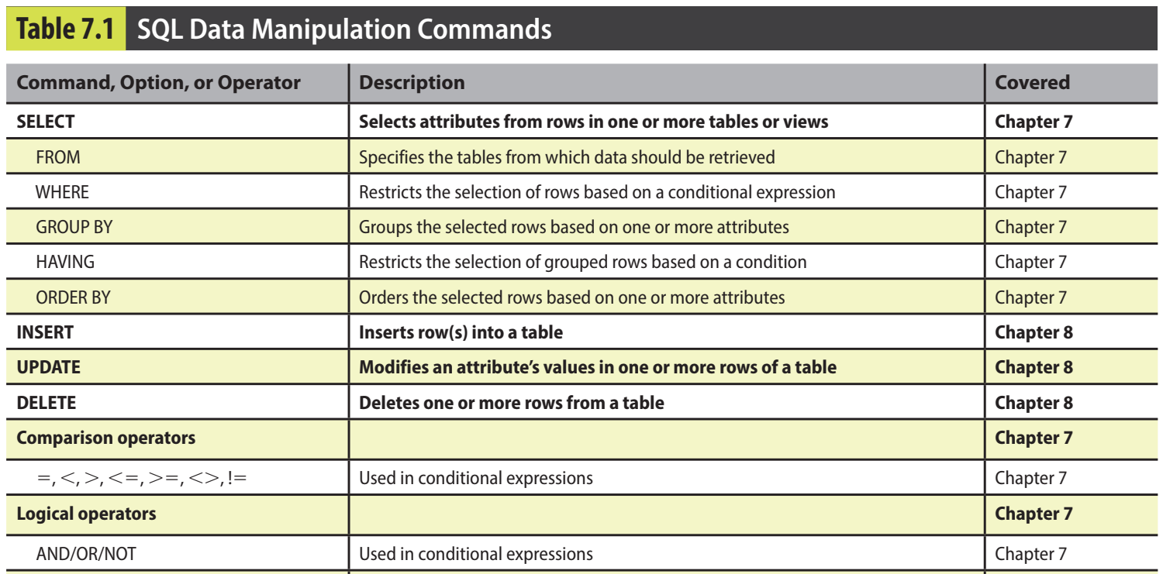

Slide 7
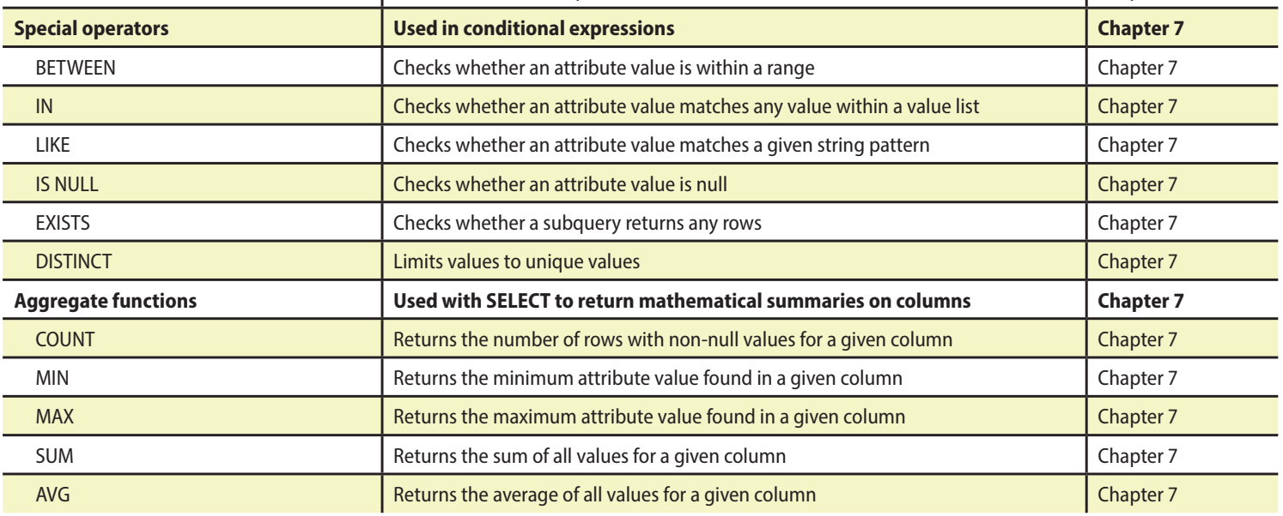

Slide 8
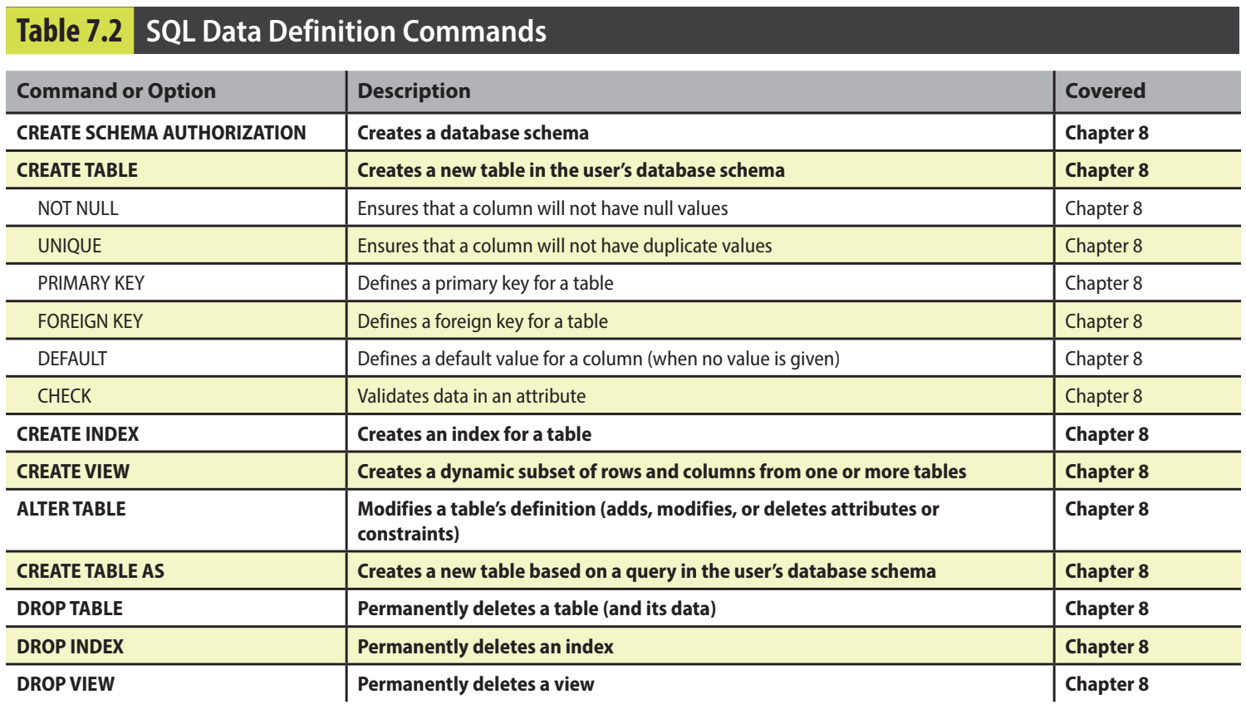

Slide 9
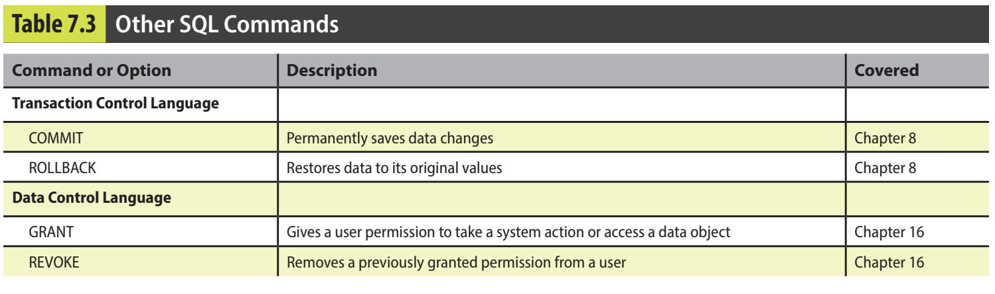

Slide 10
7-1a Data Types
The ANSI/ISO SQL standard defines many data types.
A data type is a specification about the kinds of data that can be stored in an attribute.
Character data is composed of any printable characters such as alphabetic values, digits, punctuation, and special characters.
Numeric data is composed of digits, such that the data has a specific numeric value.
Date data is composed of date and, occasionally, time values.

Slide 11
7-1b SQL Queries
in the SQL environment, the word query covers both questions and actions.
SQL queries are used to answer questions such as these: “What products currently held in inventory are priced over $100, and what is the quantity on hand for each of those products?”
SQL queries are used to perform actions such as adding or deleting table rows or changing attribute values within tables.
Data retrieval is done in SQL using a SELECT query.
RDBMS returns a set of one or more rows that have the same characteristics as a relational table
set-oriented commands

Slide 12
7-1c The Database Model
CUSTOMER, INVOICE, LINE, PRODUCT, and VENDOR
A customer may generate many invoices. Each invoice is generated by one customer.
An invoice contains one or more invoice lines. Each invoice line is associated with one invoice.
Each invoice line references one product. A product may be found in many invoice lines. (You can sell more than one hammer to more than one customer.)
A vendor may supply many products. Some vendors do not yet supply products. For example, a vendor list may include potential vendors.
If a product is vendor-supplied, it is supplied by only a single vendor.
Some products are not supplied by a vendor. For example, some products may be produced in-house or bought on the open market.

Slide 13
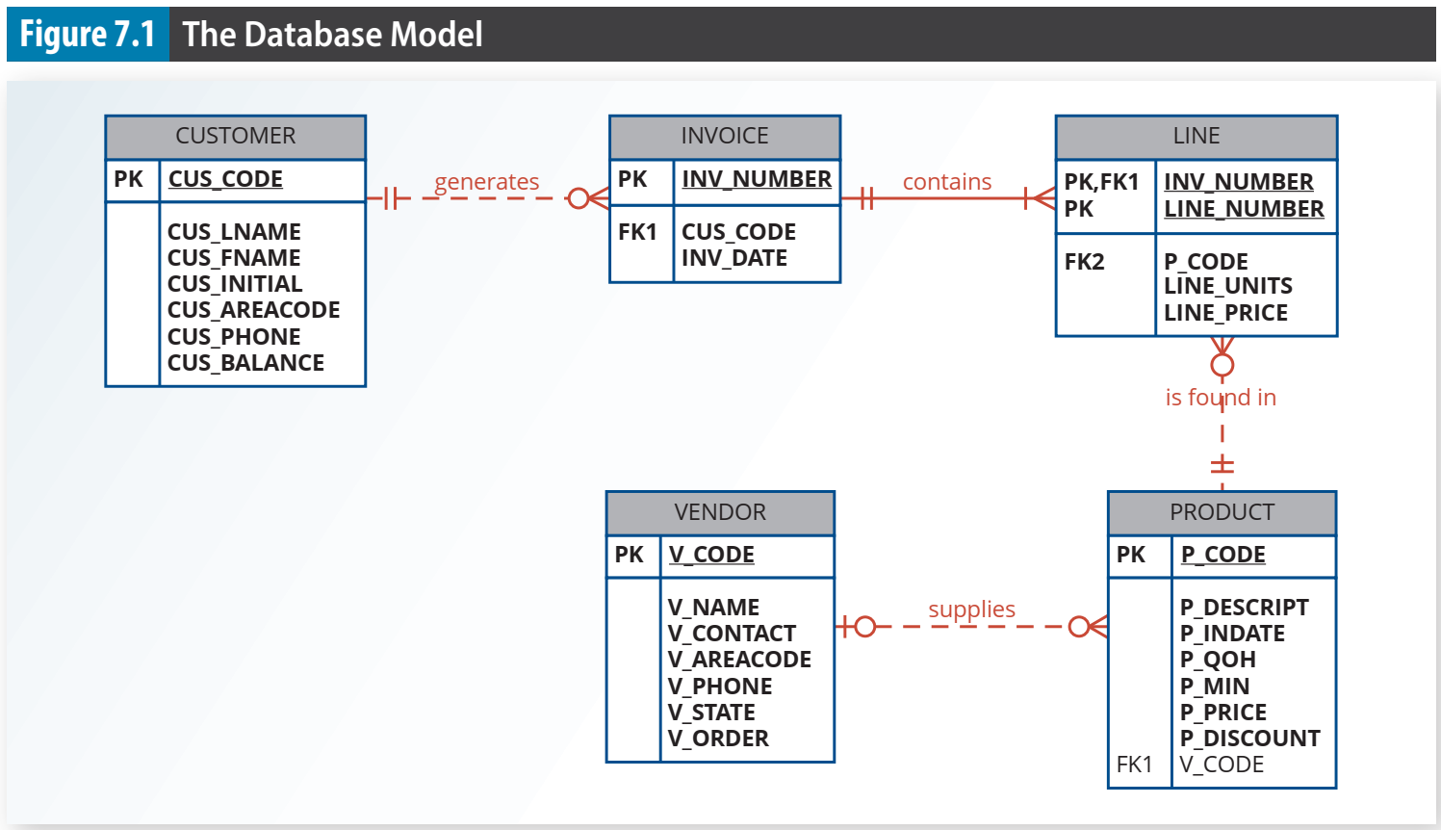

Slide 14
7-2 Basic SELECT Queries

Slide 15
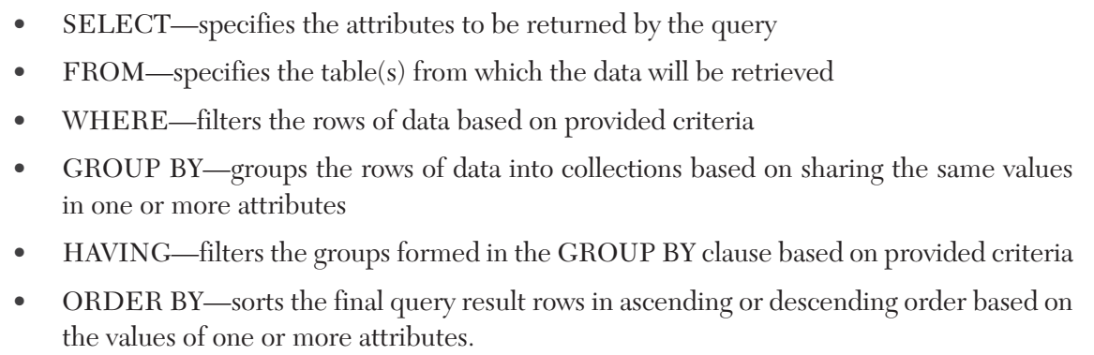

Slide 16
7-3 SELECT Statement Options

Slide 17
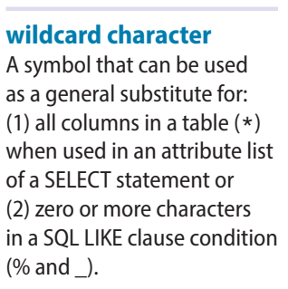
7-3 SELECT Statement Options
The SELECT query specifies the columns to be retrieved as a column list.
The syntax for a basic SELECT query that retrieves data from a table is: SELECT columnlist FROM tablelist;
The columnlist represents one or more attributes, separated by commas.
If the programmer wants all of the columns to be returned, then the asterisk (*) wildcard can be used. SELECT * FROM PRODUCT;

Slide 18
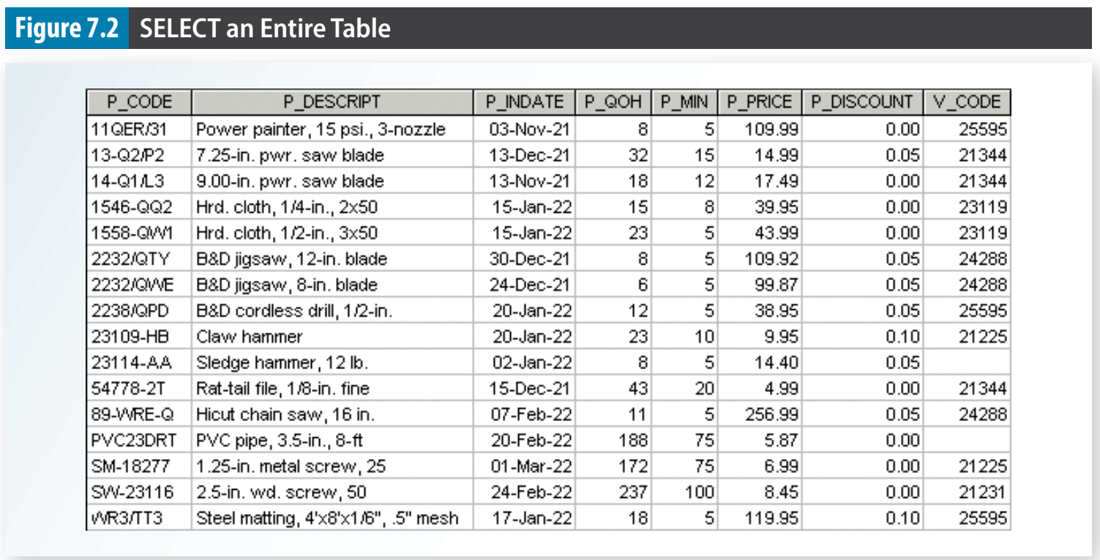


Slide 19
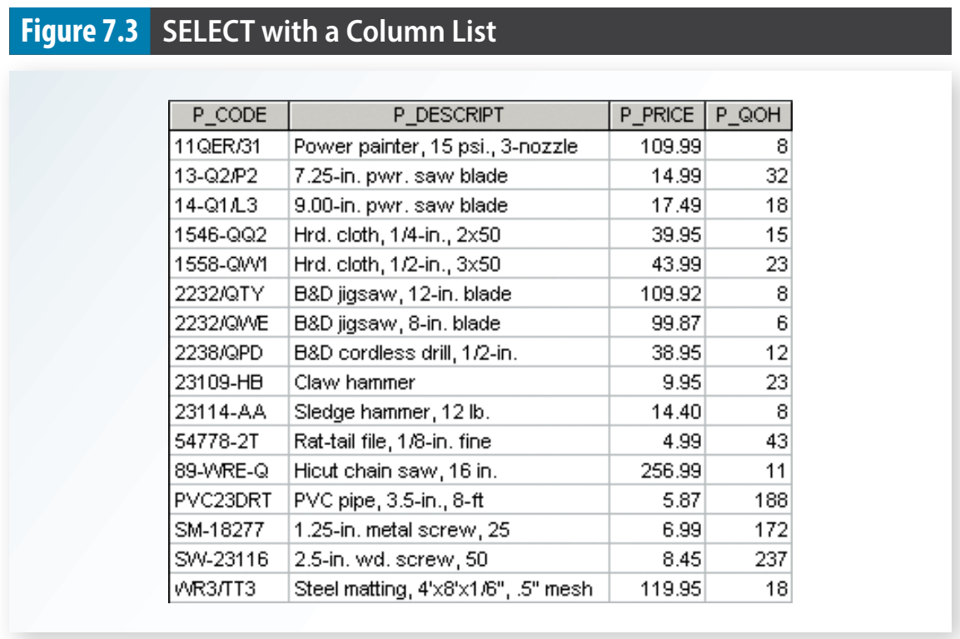


Slide 20
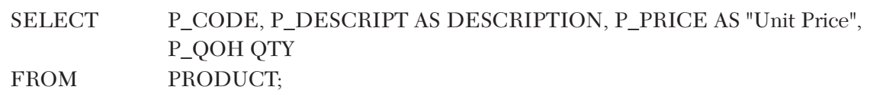
7-3a Using Column Aliases
Alias An alternative name for a column or table in a SQL statement.
Not all columns in a query must use an alias
AS is optional, but recommended
Aliases that contain a space must be inside a delimiter (quotes)

Slide 21
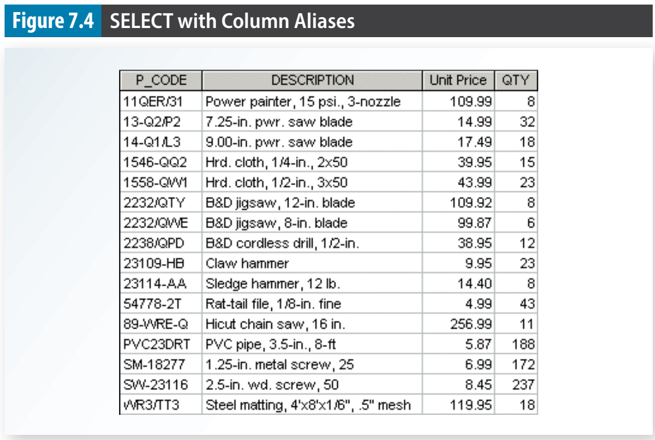

Slide 22
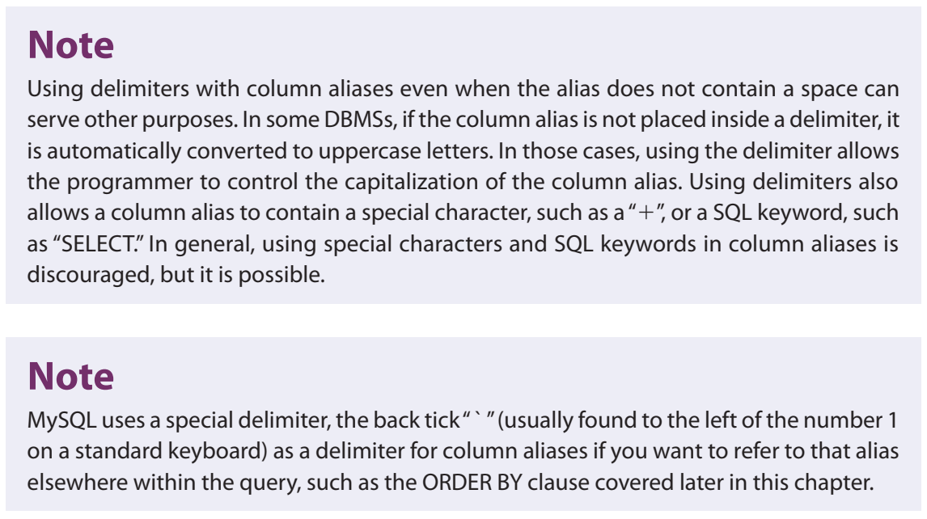

Slide 23
7-3b Using Computed Columns
A computed column (also called a calculated column) represents a derived attribute.
Suppose that you want to determine the total value of each product currently held in inventory
Require multiplying each product’s quantity on hand by its current price

Slide 24
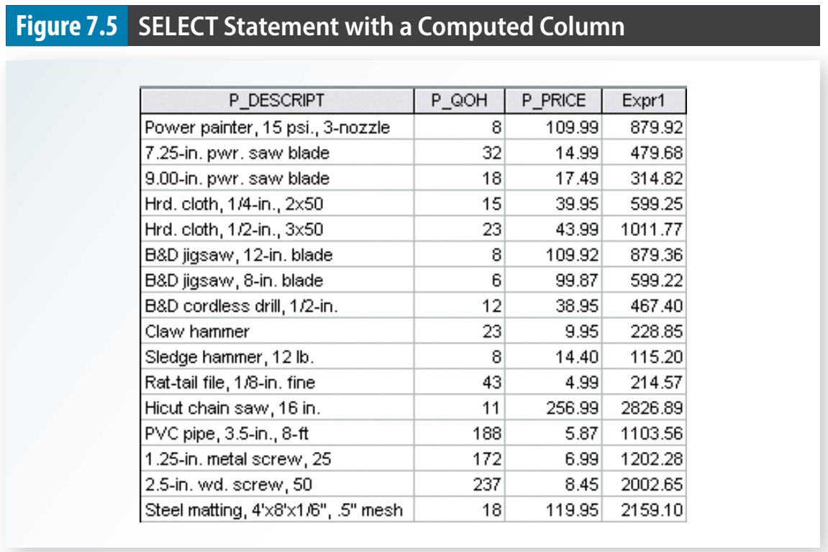

Slide 25
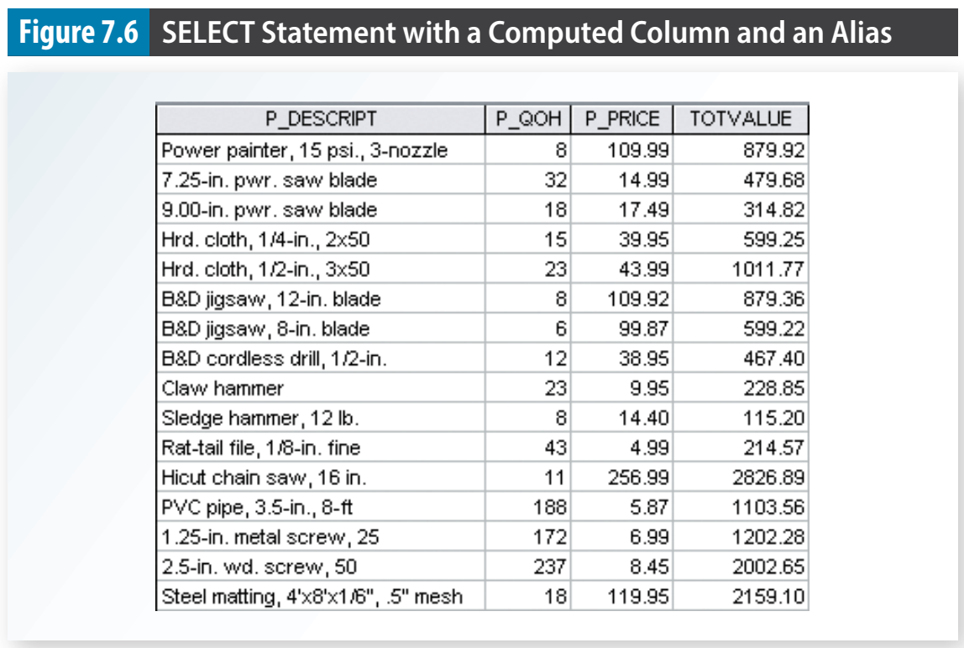

Slide 26
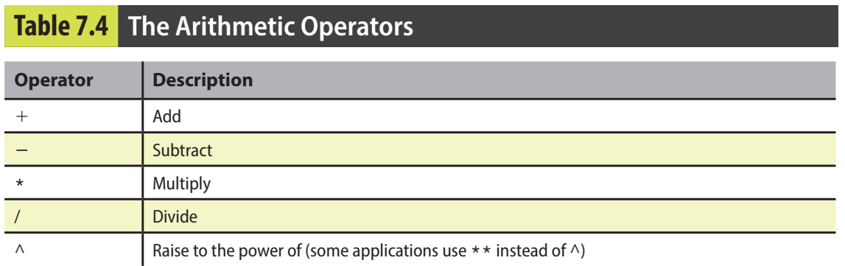
7-3c Arithmetic Operators: The Rule of Precedence
rules of precedence Basic algebraic rules that specify the order in which operations are performed

Slide 27

7-3d Date Arithmetic
a date is stored as a day number, that is, the number of days that have passed since some defined point in history
it is possible to perform date arithmetic in a query

Slide 28
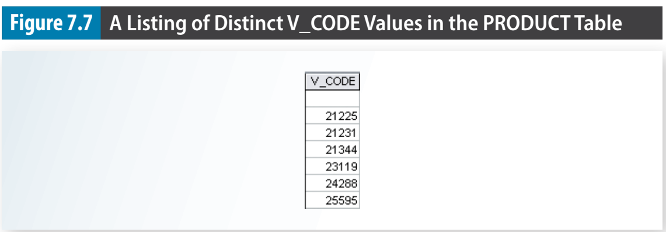
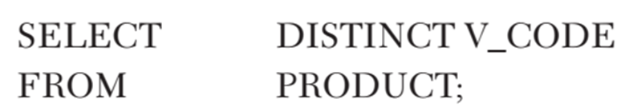
7-3e Listing Unique Values
SQL’s DISTINCT clause produces a list of only those values that are different from one another.
DISTINCT A SQL clause that produces a list of values that are different from one another.

Slide 29
7-4 FROM Clause Options

Slide 30
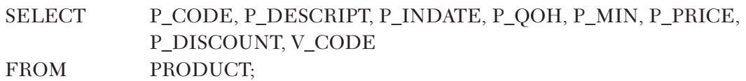

7-4 FROM Clause Options
The FROM clause of the query specifies the table or tables from which the data is to be retrieved

Slide 31
7-5 ORDER BY Clause Options

Slide 32
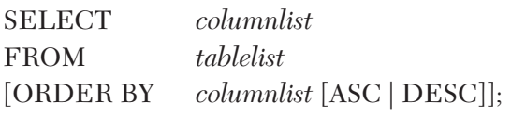
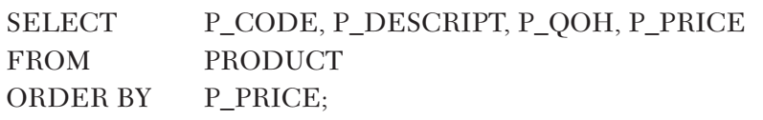
7-5 ORDER BY Clause Options
ORDER BY A SQL clause that is useful for ordering the output of a SELECT query (e.g., in ascending or descending order).

Slide 33
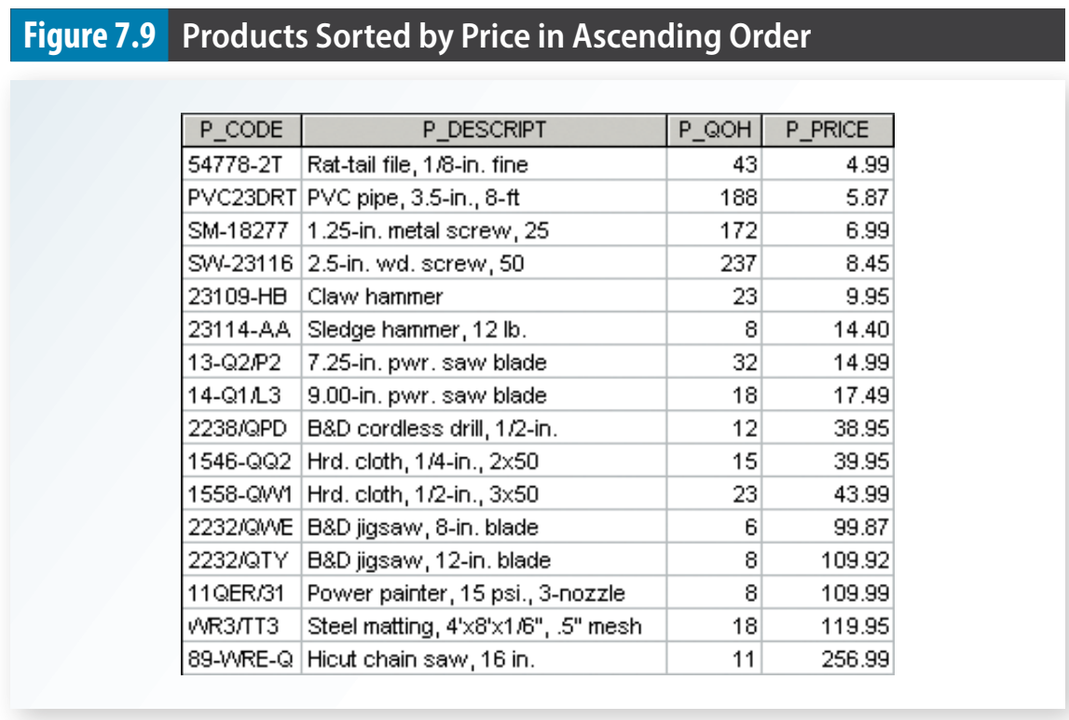

Slide 34
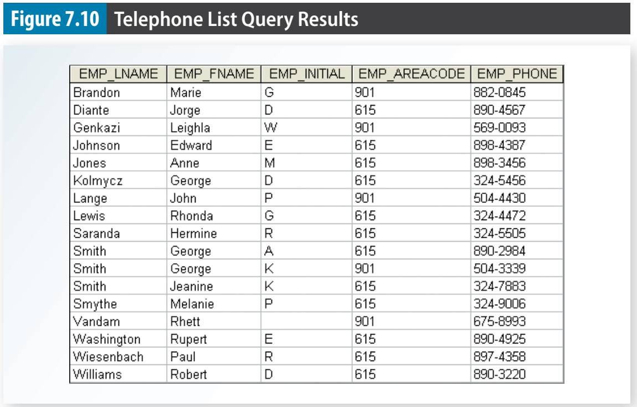
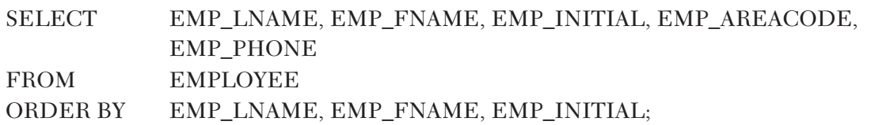

Slide 35
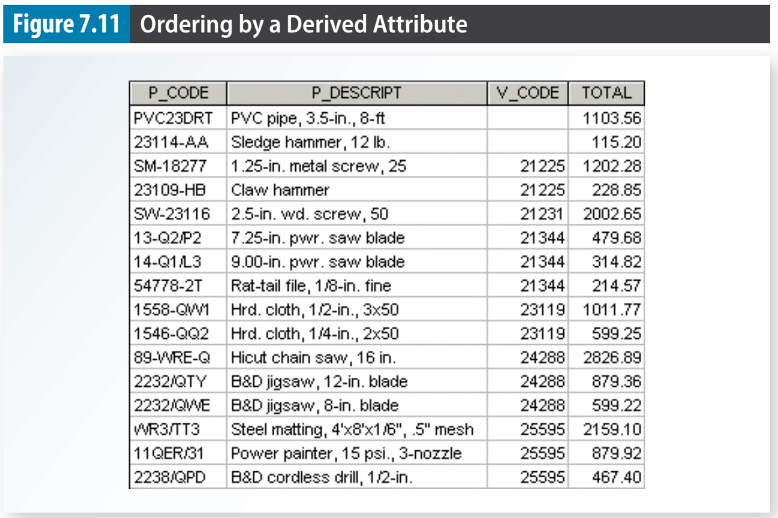
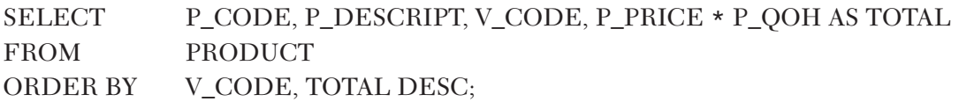

Slide 36
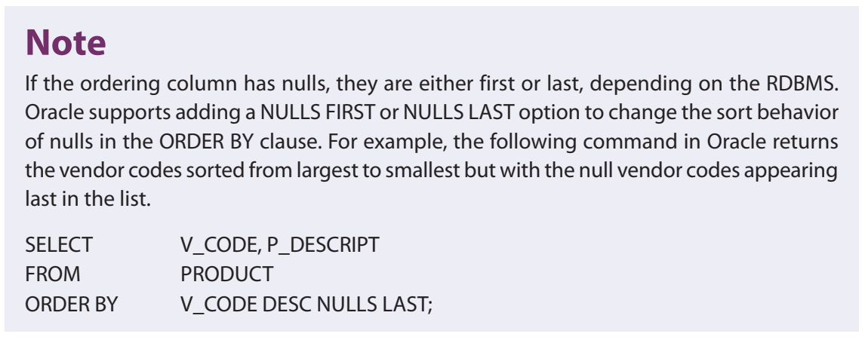

Slide 37
7-6 WHERE Clause Options

Slide 38
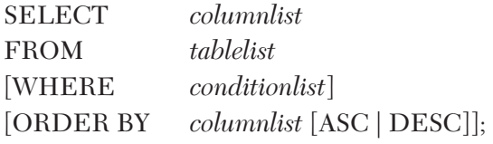
7-6a Selecting Rows with Conditional Restrictions
WHERE A SQL clause that adds conditional restrictions to a SELECT statement to limit the rows returned by the query.

Slide 39
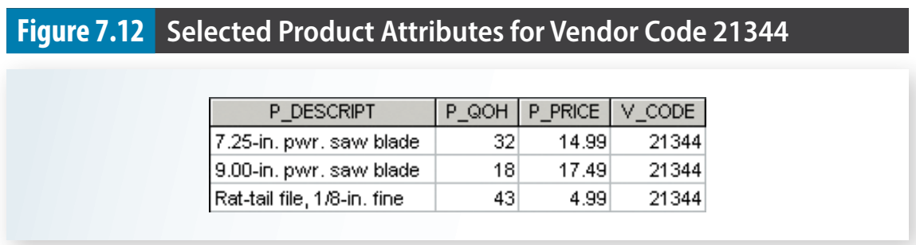
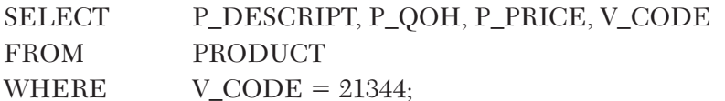

Slide 40
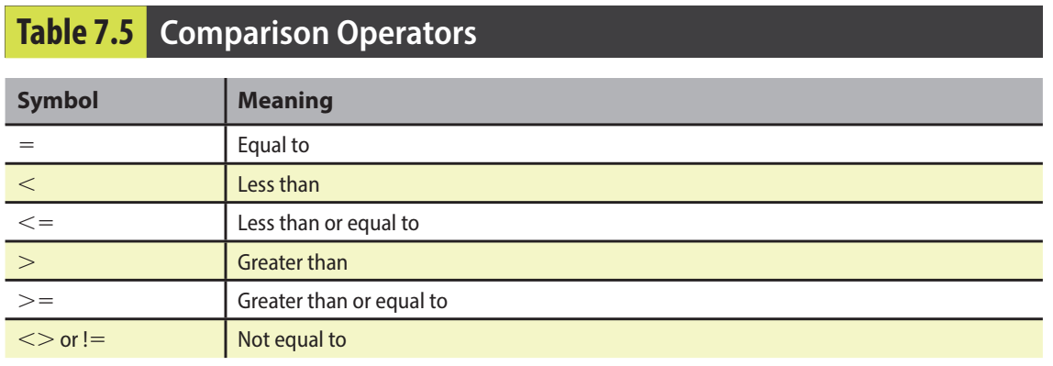

Slide 41
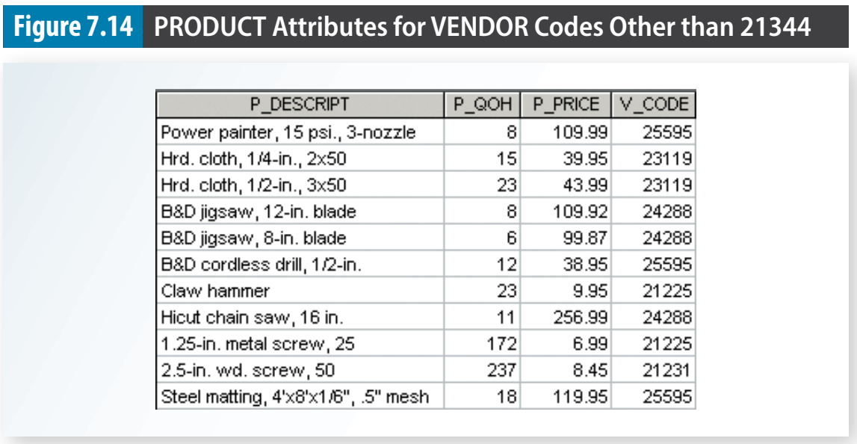
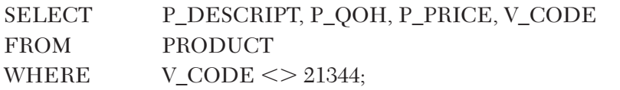

Slide 42
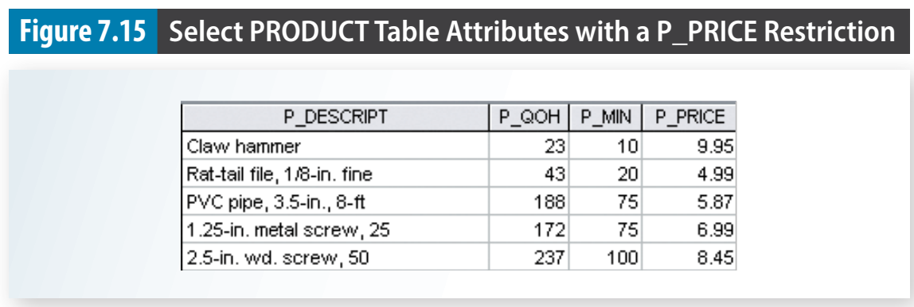
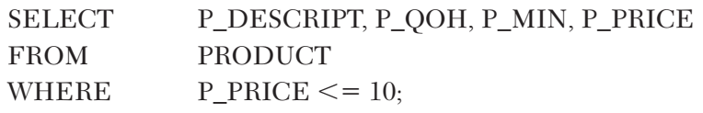

Slide 43
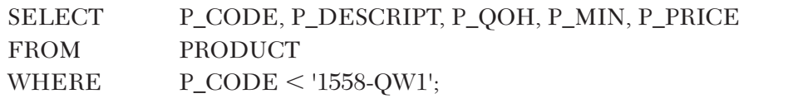
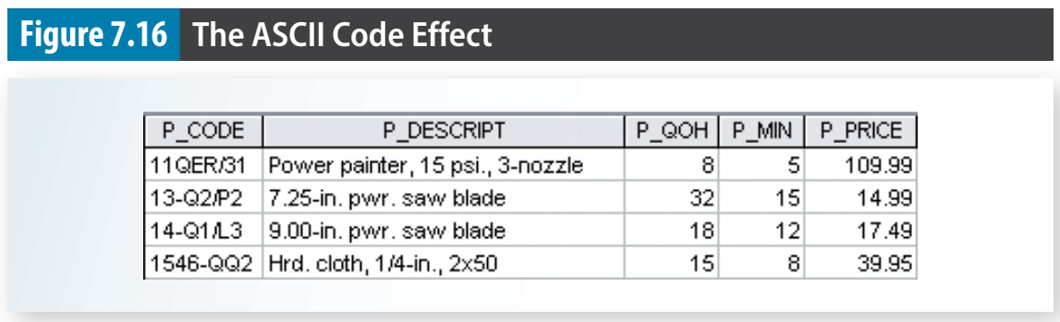
7-6b Using Comparison Operators on Character Attributes
Because computers identify all characters by their numeric American Standard Code for Information Interchange (ASCII) codes, comparison operators may even be used to place restrictions on character-based attributes.

Slide 44
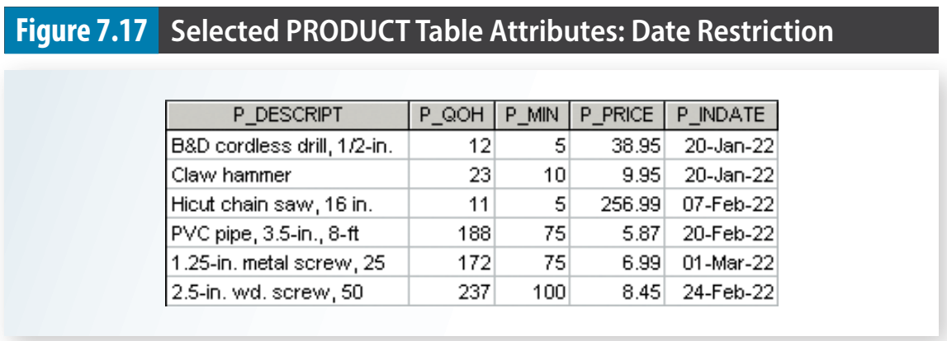
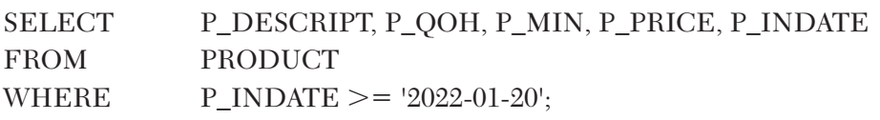
7-6c Using Comparison Operators on Dates
Date procedures are often more software-specific (Access vs Oracle, etc.) than other SQL procedures.

Slide 45
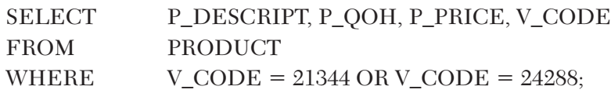
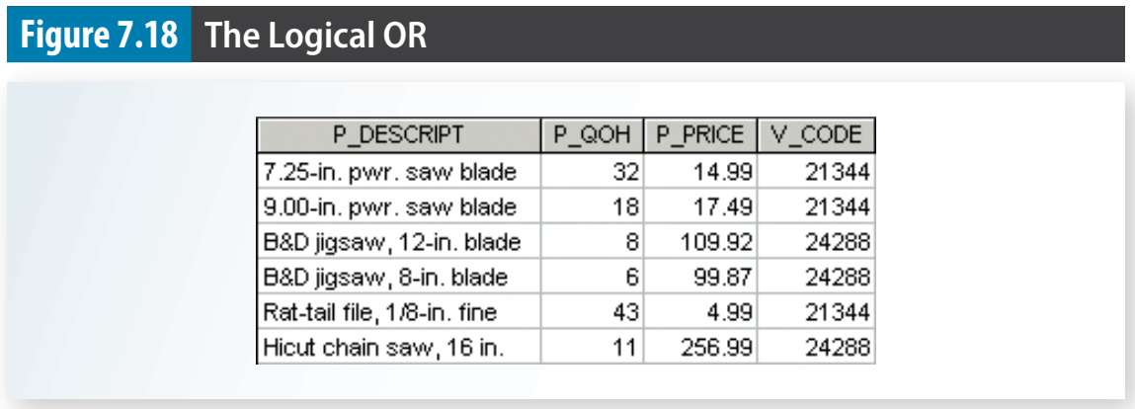
7-6d Logical Operators: AND, OR, and NOT
AND, OR, NOT

Slide 46
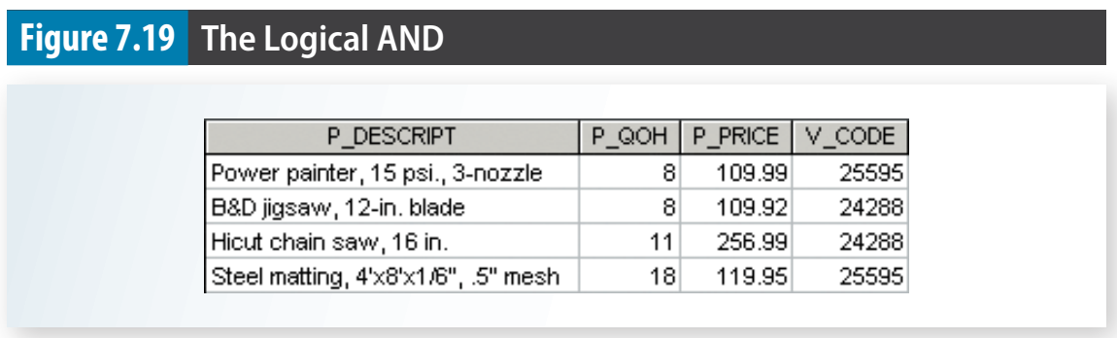
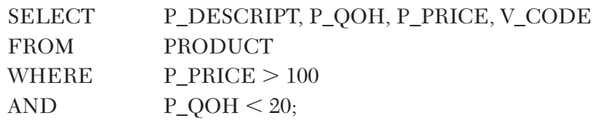

Slide 47
7-6e Special Operators
ANSI-standard SQL allows the use of special operators with the WHERE clause. These special operators include:
BETWEEN: Used to check whether an attribute value is within a range
IN: Used to check whether an attribute value matches any value within a value list
LIKE: Used to check whether an attribute value matches a given string pattern
IS NULL: Used to check whether an attribute value is null

Slide 48
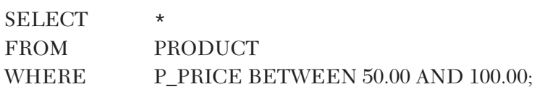
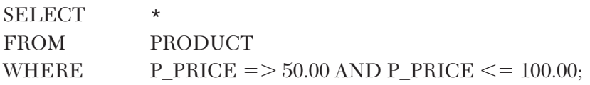
The BETWEEN Special Operator
BETWEEN In SQL, a special comparison operator used to check whether a value is within a range of specified values.
If your DBMS does not support BETWEEN, you can use:

Slide 49
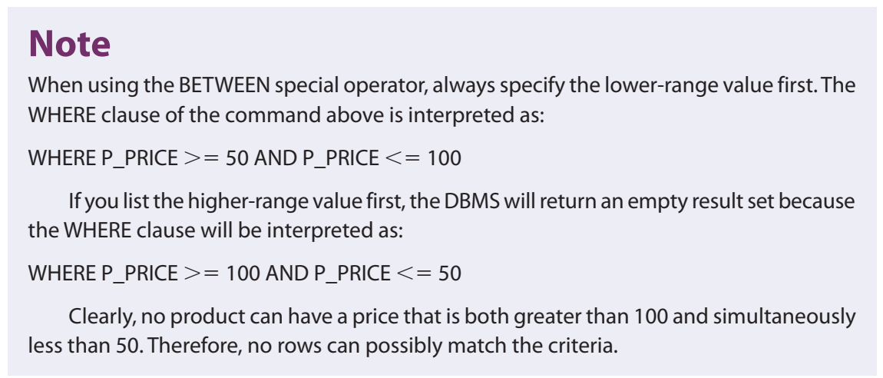

Slide 50
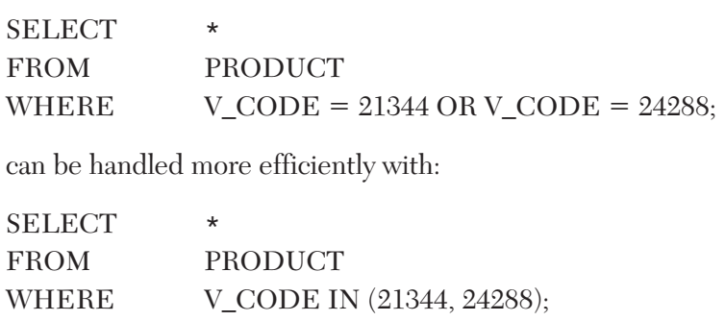
The IN Special Operator
IN In SQL, a comparison operator used to check whether a value is among a list of specified values

Slide 51
The LIKE Special Operator
LIKE In SQL, a comparison operator used to check whether an attribute’s text value matches a specified string pattern.
Standard SQL allows you to use the percent sign (%) and underscore (_) wildcard characters to make matches when the entire string is not known:

Slide 52
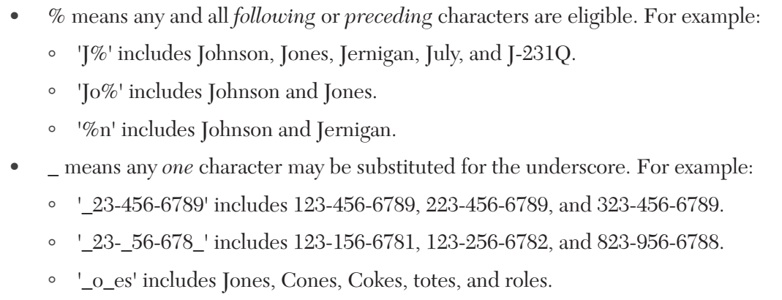

Slide 53
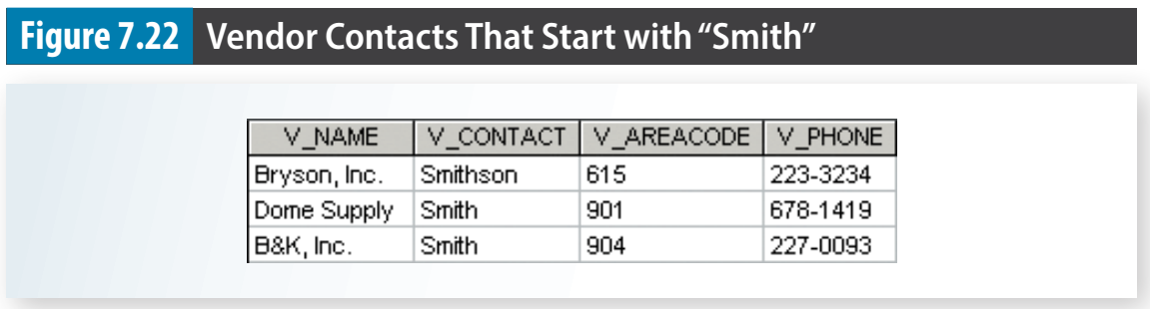
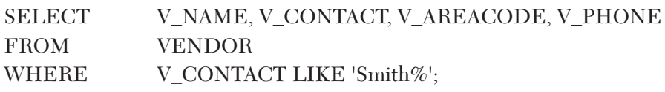

Slide 54


The IS NULL Special Operator
IS NULL In SQL, a comparison operator used to check whether an attribute has a value.

Slide 55
7-7 JOIN Operations

Slide 56
7-7a Natural Join
A natural join returns all rows with matching values in the matching columns and eliminates duplicate columns.
SELECT column-list FROM table1 NATURAL JOIN table2
The natural join performs the following tasks:
Determines the common attribute(s) by looking for attributes with identical names and compatible data types.
Selects only the rows with common values in the common attribute(s).
If there are no common attributes, returns the relational product of the two tables.

Slide 57


Slide 58


Slide 59

7-7b JOIN USING Syntax
The query returns only the rows with matching values in the column indicated in the USING clause—and that column must exist in both tables
SELECT column-list FROM table1 JOIN table2 USING (common-column)

Slide 60



Slide 61

7-7c JOIN ON Syntax
The previous two join styles use common attribute names in the joining tables. Another way to express a join when the tables have no common attribute names is to use the JOIN ON operand.
SELECT column-list FROM table1 JOIN table2 ON join-condition

Slide 62
7-7d Common Attribute Names
Queries will join tables using PK/FK combinations as the common attribute for the join criteria.
The NATURAL JOIN and JOIN USING operands automatically eliminate duplicate columns for the common attribute to avoid the issue of duplicate column names.
The JOIN ON clause does not automatically remove a copy of the common attribute, so it requires a table qualifier whenever the query references the common attribute.

Slide 63
7-7e Old-Style Joins
Avoid to join using where condition to connect two or more tables.
See more in book.

Slide 64
7-7f Outer Joins
An outer join returns not only the rows matching the join condition (that is, rows with matching values in the common columns), but also the rows with unmatched values.
The left outer join returns not only the rows matching the join condition (that is, rows with matching values in the common column), but also the rows in the left table with unmatched values in the right table.
The right outer join returns not only the rows matching the join condition (that is, rows with matching values in the common column), but also the rows in the right table with unmatched values in the left table
The full outer join returns not only the rows matching the join condition (that is, rows with matching values in the common column), but also all of the rows with unmatched values in the table on either side.

Slide 65



Slide 66



Slide 67



Slide 68



Slide 69



Slide 70

7-7g Cross Join
A cross join performs a relational product (also known as the Cartesian product) of two tables.
SELECT column-list FROM table1 CROSS JOIN table2
SELECT * FROM INVOICE CROSS JOIN LINE;

Slide 71

7-7h Joining Tables with an Alias

Slide 72
7-7i Recursive Joins
recursive query A query that joins a table to itself.
Using the data in the EMP table, you can generate a list of all employees with their managers’ names by joining the EMP table to itself.

Slide 73


Slide 74
7-8 Aggregate Processing

Slide 75

7-8a Aggregate Functions

Slide 76



Slide 77



Slide 78


Slide 79


Slide 80

MIN and MAX

Slide 81


SUM and AVG

Slide 82



Slide 83

7-8b Grouping Data
Rows can be grouped into smaller collections quickly and easily using the GROUP BY clause within the SELECT statement.
The aggregate functions will then summarize the data within each smaller collection.

Slide 84


Slide 85

7-8c HAVING Clause
HAVING A clause applied to the output of a GROUP BY operation to restrict selected rows.

Slide 86


Slide 87
7-9 Subqueries

Slide 88


7-9 Subqueries
Subquery A query that is embedded (or nested) inside another query. Also known as a nested query or an inner query.

Slide 89


Slide 90


7-9a WHERE Subqueries

Slide 91

7-9b IN Subqueries

Slide 92

7-9c HAVING Subqueries

Slide 93

7-9d Multirow Subquery Operators: ALL and ANY
which products cost more than all individual products provided by vendors from Florida

Slide 94

7-9e FROM Subqueries

Slide 95
7-10 SQL Functions

Slide 96



Slide 97



Slide 98



Slide 99


Slide 100


Slide 101


Slide 102


Slide 103


Slide 104


Slide 105


Slide 106


Slide 107


Slide 108


Slide 109


Slide 110


Slide 111


Slide 112


